Slide 1
Python Part 2
Judy H. Shen & Megan Leszczynski (NLP)
07/01/2021

Slide 2
Recap
We made our first colab notebook!
We saw variables
We saw conditionals (if/elif/else statements)
We saw lists (e.g. [1, 2.5, “apples”])
We saw loops (while and for)

Slide 3
Today
More data structures
Tuples
Dictionaries
Sets
Functions
Libraries
Functions and libraries make writing large programs that perform complicated operations feasible!

Slide 4
Tuples
Like a list, but you can’t reorder, add, or remove elements in it
our_tuple = (“apple”, “orange”, “strawberry”)
Notice we’re using () and not []

Slide 5
Tuples
Like a list, but you can’t reorder, add, or remove elements in it
our_tuple = (“apple”, “orange”, “strawberry”)
What happens if you try to do:
our_tuple = (“apple”, “orange”)
our_tuple[1] = “strawberry”
Notice we’re using () and not []

Slide 6
Tuples
Like a list, but you can’t reorder, add, or remove elements in it
our_tuple = (“apple”, “orange”, “strawberry”)
What happens if you try to do:
our_tuple = (“apple”, “orange”)
our_tuple[1] = “strawberry”
Tuples are immutable - you can’t change their contents
Notice we’re using () and not []

Slide 7
Sets
A collection of unique elements
our_set = {1, 2, 4, 5}

Slide 8
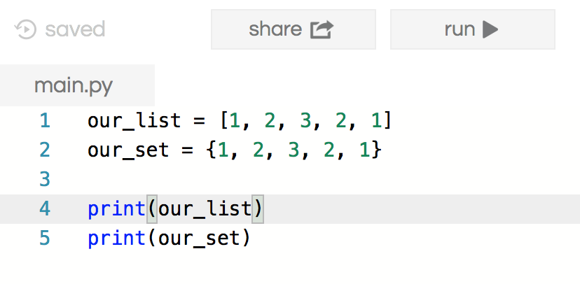
Sets
A collection of unique elements
What would the following print?
Notice we’re using {} for our set, and [] for our list

Slide 9
Dictionaries
With lists, you access elements using their index number
For many things, this might not be very useful, especially when you don’t know the index number of your element

Slide 10
Dictionaries
With lists, you access elements using their index number
For many things, this might not be very useful, especially when you don’t know the index number of your element
A dictionary allows us to access elements based on keys

Slide 11
Dictionaries
With lists, you access elements using their index number
For many things, this might not be very useful, especially when you don’t know the index number of your element
A dictionary allows us to access elements based on keys
our_dict = {
“apple”: 10,
“orange”: 20,
}
print(our_dict[“apple”])

Slide 12
Dictionaries
We can imagine a dictionary in Python like a dictionary in real life
our_dictionary = {“word”: “a definition of that word”}
print(our_dictionary)

Slide 13
Dictionaries
We can imagine a dictionary in Python like a dictionary in real life
our_dictionary = {
“word”: “a definition of that word”
}
print(our_dictionary)
To get the definition of “word”, you would run:
print(our_dictionary[“word”])
We call this the “key”
This is its “value”

Slide 14
Functions

Slide 15
Functions
A way for us to reuse common pieces of code
One of the most powerful and useful concepts in programming

Slide 16
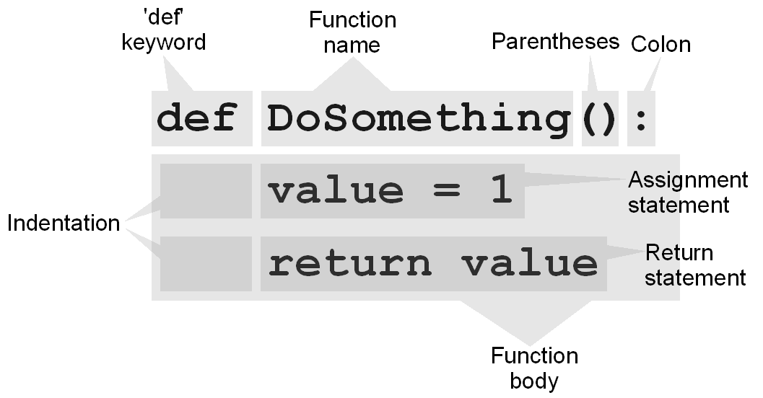
Functions
A way for us to reuse common pieces of code
One of the most powerful and useful concepts in programming
An example of a function:
Notes:
Talk through the different components of this function, and what it does!

Slide 17
Functions
Parameters are values that you pass to a function
Functions can return values (but do not have to)
What does the following print?
def silly_function(a):
return a
value = silly_function(10)
print(value)

Slide 18
Functions
Parameters are values that you pass to a function
Functions can return values (but do not have to)
What does the following print?
def silly_function():
return 10
value = silly_function()
print(value)
We define the function here
We call the function here

Slide 19
Functions
In fact, the first thing we learned was how to call a function!

Slide 20
Functions
In fact, the first thing we learned was how to call a function!
The print() function!

Slide 21
Functions
In fact, the first thing we learned was how to call a function!
The print() function!
This is a function that the creators of Python have written, so that we do not have to re-code the complexities of printing to the screen every time we want to print

Slide 22
Functions
In fact, the first thing we learned was how to call a function!
The print() function!
This is a function that the creators of Python have written, so that we do not have to re-code the complexities of printing to the screen every time we want to print
How many parameters does the print() function take?

Slide 23
Functions
In fact, the first thing we learned was how to call a function!
The print() function!
This is a function that the creators of Python have written, so that we do not have to re-code the complexities of printing to the screen every time we want to print
Referred to as a built-in function
int(), str()
More here: https://docs.python.org/3/library/functions.html

Slide 24
Functions
What does the following print?
def sum(a, b):
return a + b
print(sum(1, 2))
How many parameters does this function take?

Slide 25
Exercise 1
Using an if statement, write a function named larger that takes two parameters and returns the larger one.
Notes:
Can be done if there’s time in the class, or left for a later time
One thing to make sure to note is -- how do you know what type of variable the parameters are? How do you make sure the function in the challenge question takes in a list? Can you?

Slide 26
Exercise 2
Write a function that takes a list and a value, and prints out all of the numbers in the list that are smaller than that value.

Slide 27
Using Libraries

Slide 28


Slide 29
Using Libraries
One of the key reasons why Python is so powerful is the ability to use code that others have already written!

Slide 30
Using Libraries
One of the key reasons why Python is so powerful is the ability to use code that others have already written!
For example, how can we take the square root of a number?
import math
print(math.sqrt(25))

Slide 31
Using Libraries
One of the key reasons why Python is so powerful is the ability to use code that others have already written!
For example, how can we take the square root of a number?
import math
print(math.sqrt(25))
By using import, we access code (often in the form of functions) that others have written, so that we don’t have to re-write that code

Slide 32
Using Libraries
One of the key reasons why Python is so powerful is the ability to use code that others have already written!
For example, how can we take the square root of a number?
import math
print(math.sqrt(25))
By using import, we access code (often in the form of functions) that others have written, so that we don’t have to re-write that code
This is especially useful for AI, as there are many AI-specific libraries (like sklearn, PyTorch, TensorFlow) that we can use

Slide 33



sklearn
tensorflow
matplotlib
pandas

Slide 34

Manipulating data with numpy
Yesterday you saw lists…
How do you add 1 to every element of a list?

Slide 35
Manipulating data with numpy
Yesterday you saw lists…
How do you add 1 to every element of a list?
L = [0, 1, 2, 3, 4]
L + 1

Slide 36
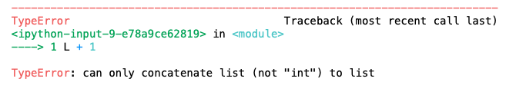

Manipulating data with numpy
Yesterday you saw lists…
How do you add 1 to every element of a list?
L = [0, 1, 2, 3, 4]
L + 1

Slide 37
Manipulating data with numpy
Yesterday you saw lists…
How do you multiply every element of a list by 2?

Slide 38
Manipulating data with numpy
Yesterday you saw lists…
How do you multiply every element of a list by 2?
L = [0, 1, 2, 3, 4]
L*2

Slide 39

Manipulating data with numpy
Yesterday you saw lists…
How do you multiply every element of a list by 2?
L = [0, 1, 2, 3, 4]
L*2
-> [1, 2, 3, 4, 5, 1, 2, 3, 4, 5]

Slide 40
Manipulating data with numpy
With numpy you can apply the same operation to all elements of an array quickly and easily
L = np.asarray([0, 1, 2, 3, 4])
L + 1
→ array([1, 2, 3, 4, 5])

Slide 41
Manipulating data with numpy
With numpy you can apply the same operation to all elements of an array quickly and easily
L = np.asarray([0, 1, 2, 3, 4])
L*2
→ array([0, 2, 4, 6, 8])

Slide 42
Using numpy
You can do many different operations!
L = np.asarray([0, 1, 2, 3, 4])
Square root: np.sqrt(L)
Trig functions Sin, Cos, Tan: np.sin(L)
Exponents: np.exp(L)

Slide 43
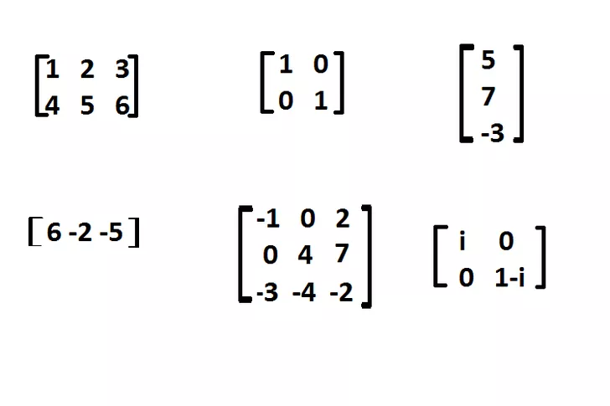
Using numpy
What about matrices?

Slide 44
Using numpy
What about matrices?
M = np.asarray([ [1, 2, 3],
[4, 5, 6] ])
They are just arrays stacked together :)

Slide 45
Using numpy
You can also find out more about your array
M = np.asarray([ [1, 2, 3],
[4, 5, 6] ])
L.ndim 2
L.shape (2, 3)
L.size 6
L.dtype dtype('int64')

Slide 46
Using numpy
You can also fill your matrix quickly
M = np.zeros(shape=(3, 3))
Array of size 3 x 3 with all zeros

Slide 47
Using numpy
You can also fill your matrix quickly
M = np.zeros(shape=(3, 3))
Array of size 3 x 3 with all zeros
M = np.ones(shape=(3, 3))
Array of size 3 x 3 with all ones

Slide 48
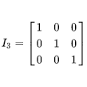
Using numpy
You can also fill your matrix quickly
M = np.zeros(shape=(3, 3))
Array of size 3 x 3 with all zeros
M = np.ones(shape=(3, 3))
Array of size 3 x 3 with all ones
M = np.eye(M=3)
Array of size 3x3 with ones in the diagonal entries

Slide 49
Using numpy
You can also fill your matrix quickly
M = np.zeros(shape=(3, 3))
Array of size 3 x 3 with all zeros
M = np.ones(shape=(3, 3))
Array of size 3 x 3 with all ones
M = np.eye(M=3)
Array of size 3 x 3 with ones in the diagonal entries
M = np.random.rand(3, 3)
Array of size 3 x 3 with random value between [0, 1)

Slide 50
Numpy Questions?

Slide 51

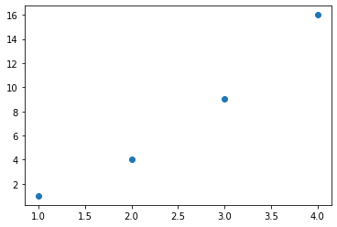
Visualizing
We will need to plot stuff!
We can do it using a cool library, called matplotlib
import matplotlib.pyplot as plt
plt.scatter([1, 2, 3], [1, 4, 9])
We will see more in the notebook!

Slide 52
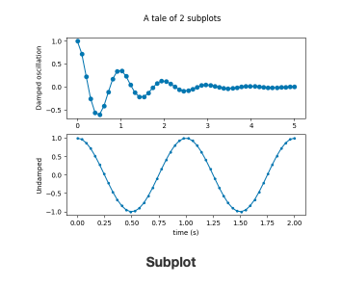
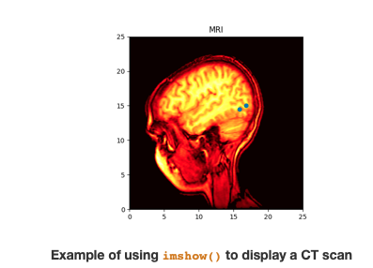
Visualizing
You can plot all different kinds of plots

Slide 53
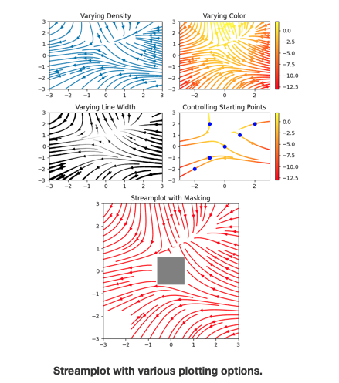
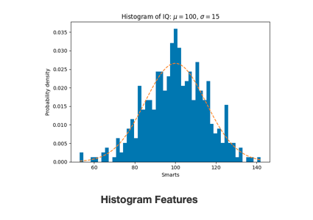
Visualizing
You can plot all different kinds of plots

Slide 54
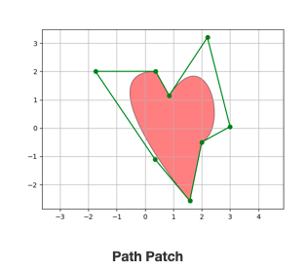
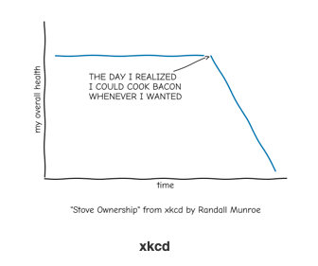
Visualizing
EVEN THE FUN PLOTS

Slide 55
Matplotlib Questions?

Slide 56

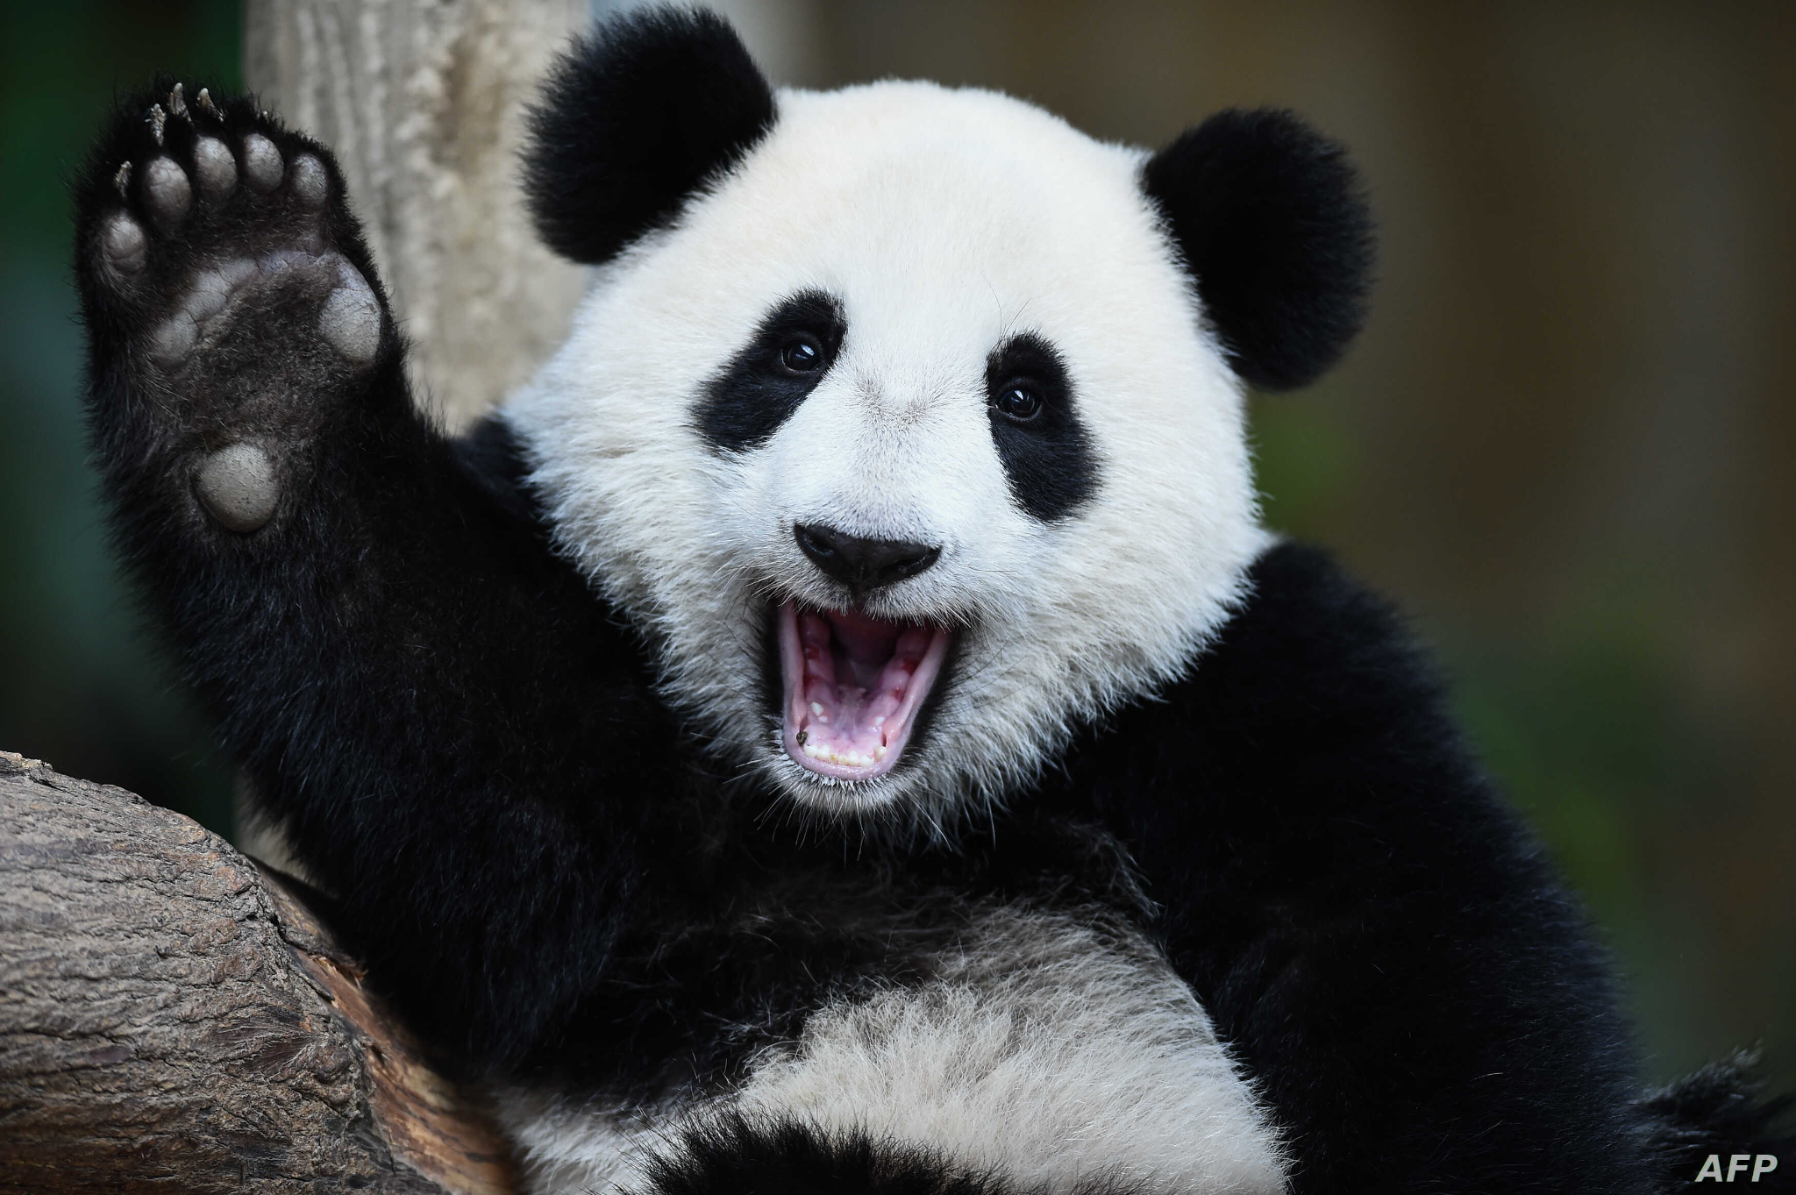
Reading and exploring data
Pandas is a library for data manipulation and analysis
Why is it call Pandas?

Slide 57
Reading and exploring data
Pandas is a library for data manipulation and analysis
Why is it call Pandas?
Panel
Data

Slide 58
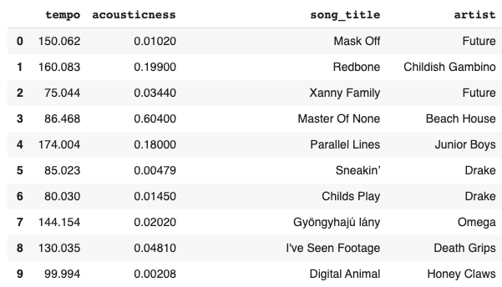
Reading and exploring data
Pandas library lets us store data in a table data structure called: DataFrame

Slide 59
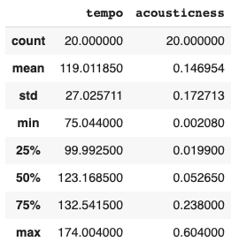
Reading and exploring data
We can quickly read dataset features:
df.describe()

Slide 60
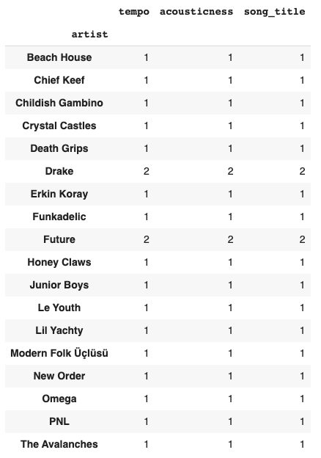
Reading and exploring data
We can easily manipulate data:
Add new columns
Remove columns
Drop missing values
Pivot data
Group by values
You will see more in the in class activity

Slide 61
Pandas Questions?

Slide 62

Training models with sklearn
Library that helps you do machine learning in Python!
Modules for
model training
prediction
model selection
pre processing and more!

Slide 63
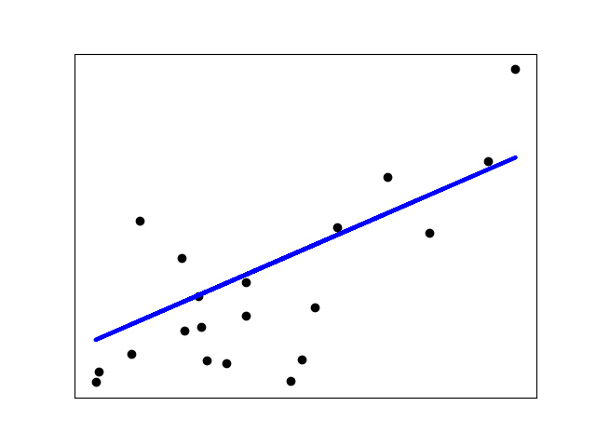
Training models with sklearn
Basic example:

Slide 64
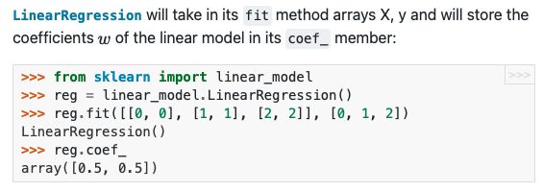
Training models with sklearn
Basic example:
Import the model

Slide 65
Training models with sklearn
Basic example:
Import the model
Declare model

Slide 66
Training models with sklearn
Basic example:
Import the model
Declare model
Fit data

Slide 67
Training models with sklearn
Basic example:
Import the model
Declare model
Fit data

Slide 68
Recap: Libraries
Go over usefulness of libraries and what we just saw
Tell them that they’ll use many of these libraries throughout their projects!

Slide 69
Questions?

Slide 70
Python Resources

Slide 71
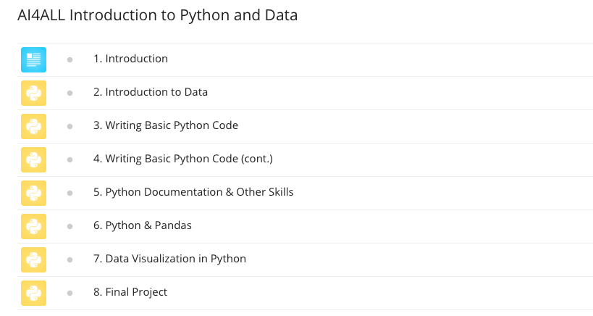
ed class
Try to finish all the modules as soon as possible!
But let your instructors know if you were not able to

Slide 72
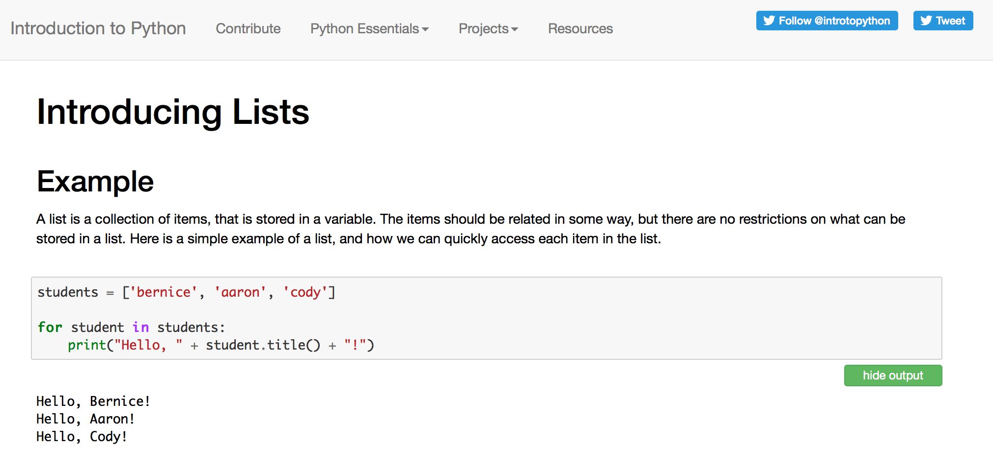
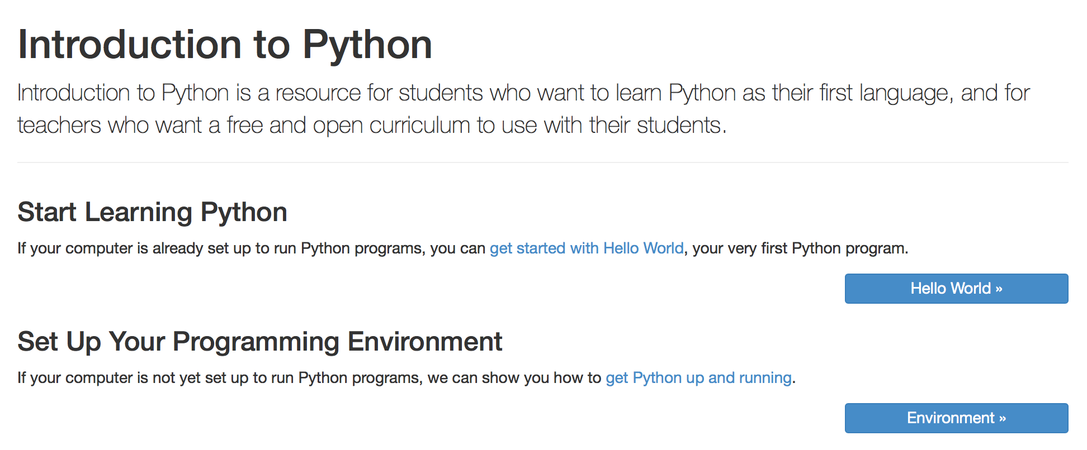
Other Resources for Learning Python
http://introtopython.org

Slide 73
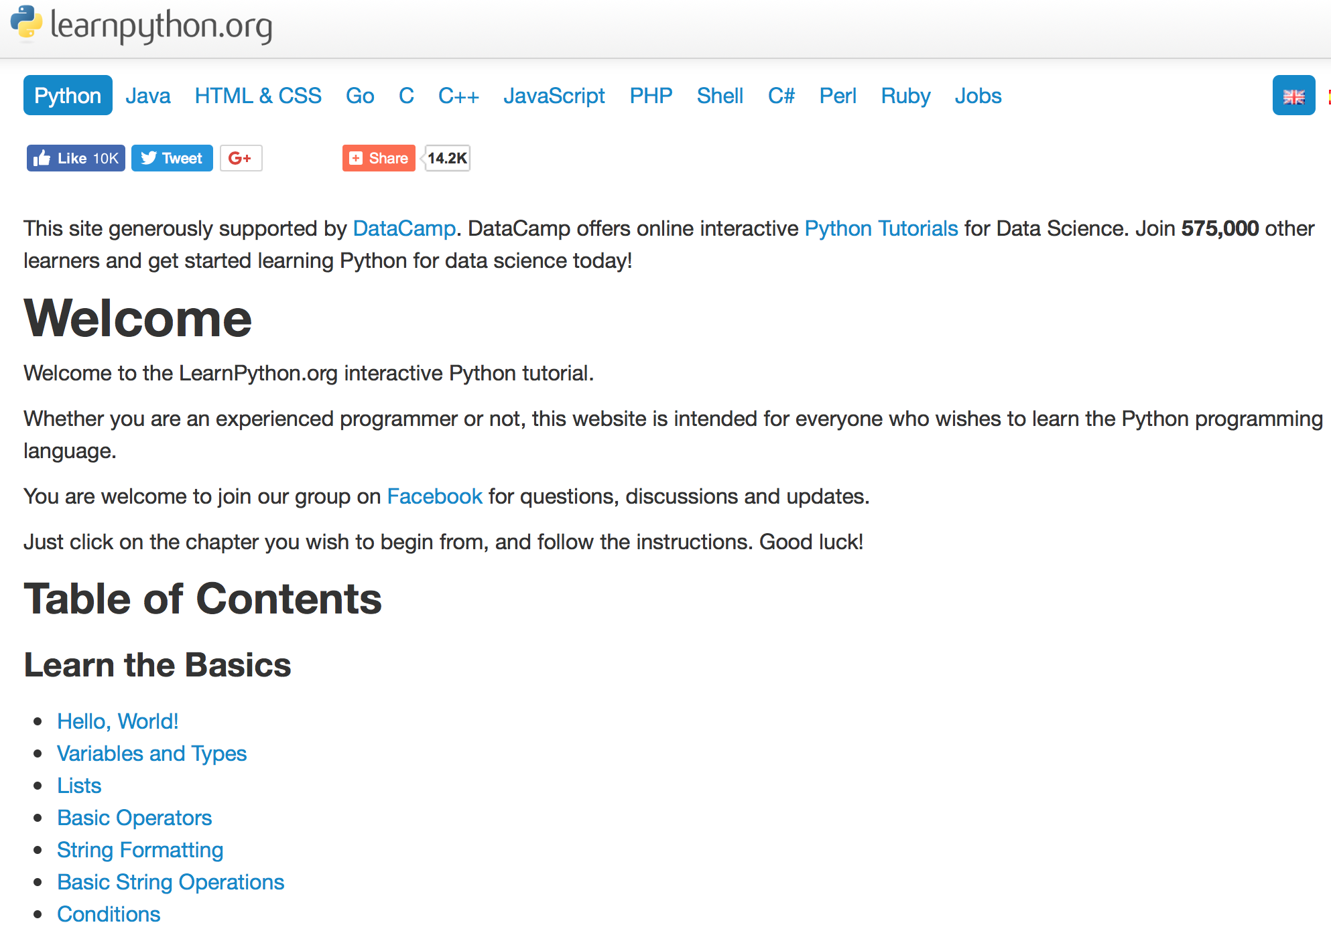
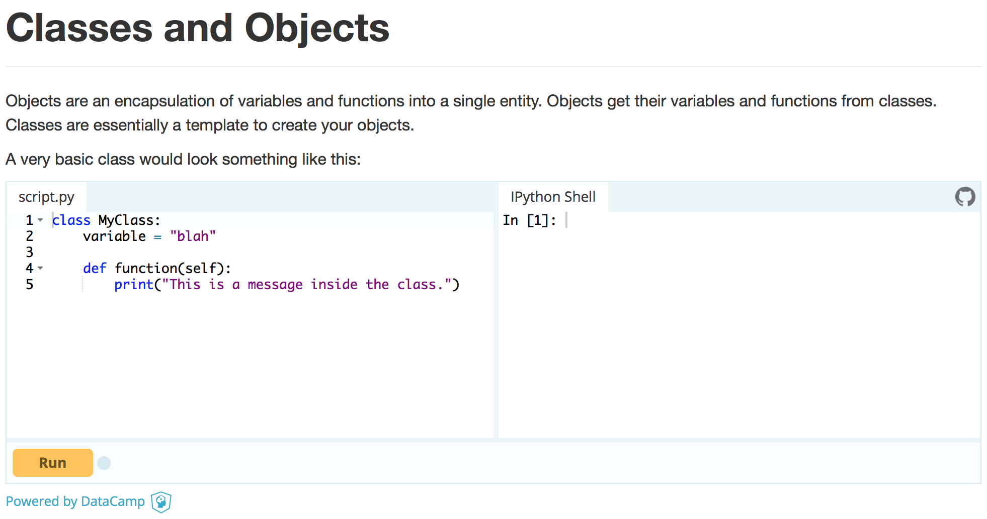
Other Resources for Learning Python
https://www.learnpython.org
https://www.learnpython.org

Slide 74
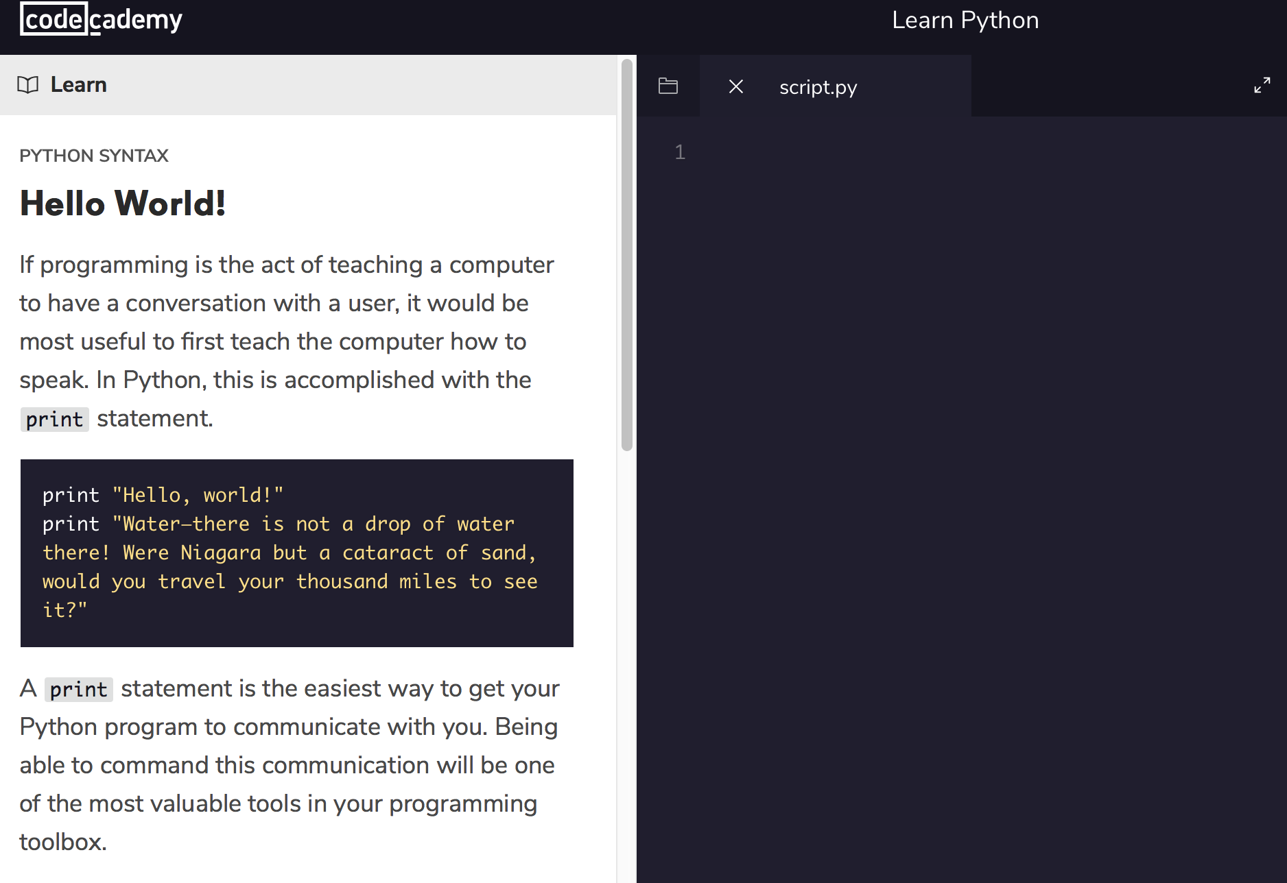
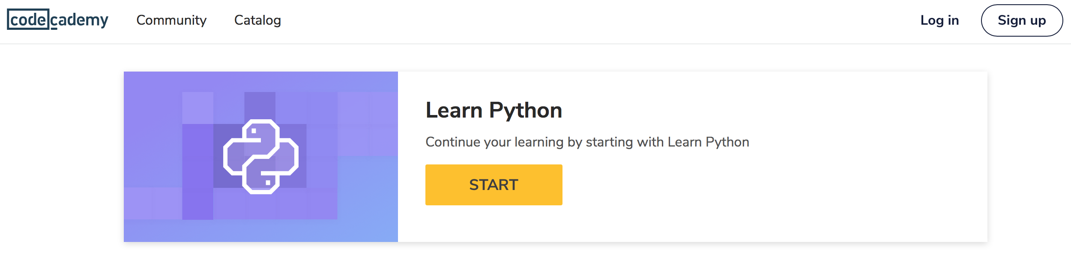
Other Resources for Learning Python
https://www.codecademy.com/learn/learn-python

